Slide 1
6A
READING IN ENGLISH

Slide 2

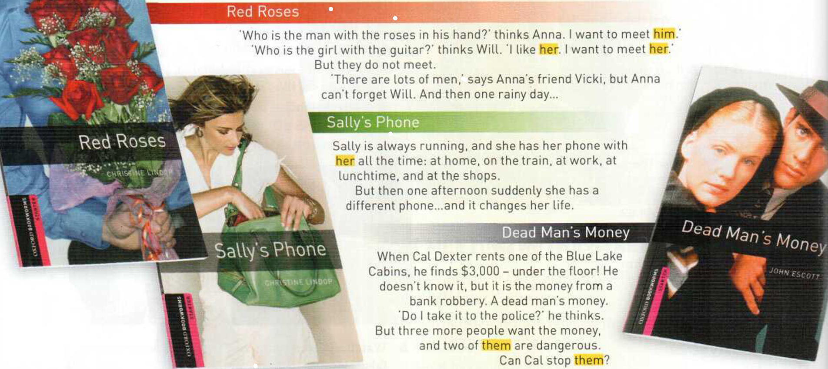

Slide 3
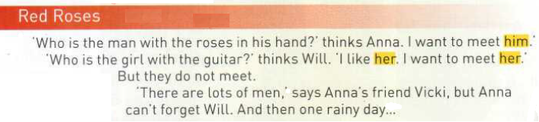
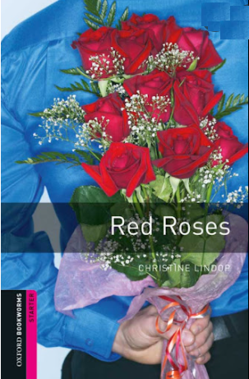
WHAT HAPPENS?
Probably they meet.
BACK COVER OF THE BOOK
on
FRONT COVER OF THE BOOK

Slide 4
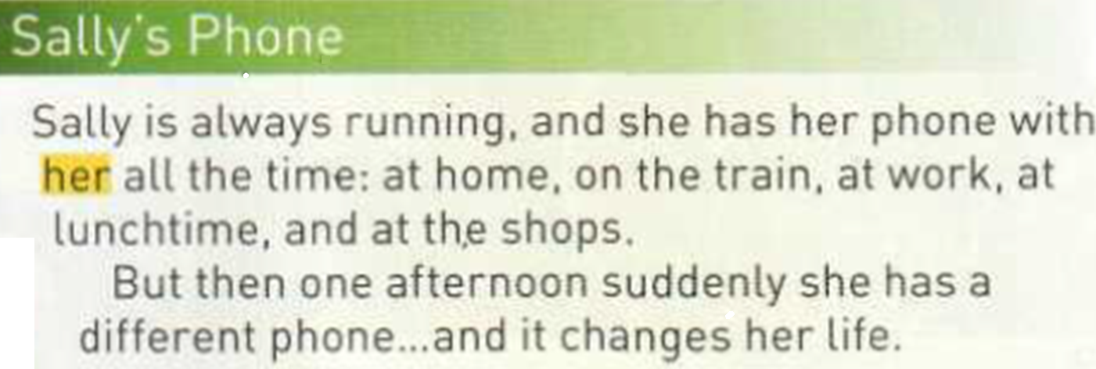
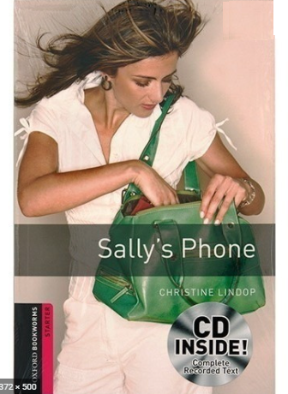
BACK COVER OF THE BOOK
FRONT COVER
WHAT HAPPENS?

Slide 5
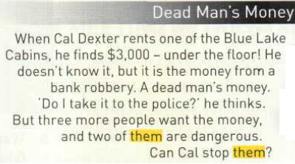
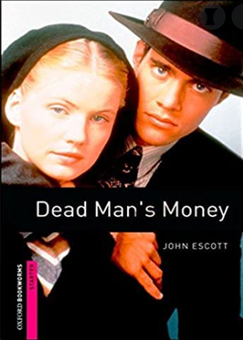

FRONT COVER
BACK COVER

Slide 6
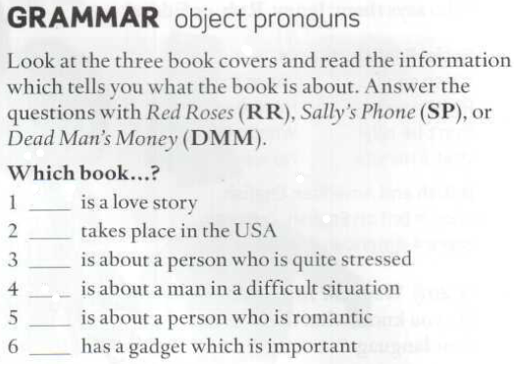
MEMORIZE THE QUESTIONS
Red Roses
Dead man’s money
Sally’s phone
MEMORIZE THE ANSWERS
Dead man’s money
Red Roses
Sally’s phone

Slide 7
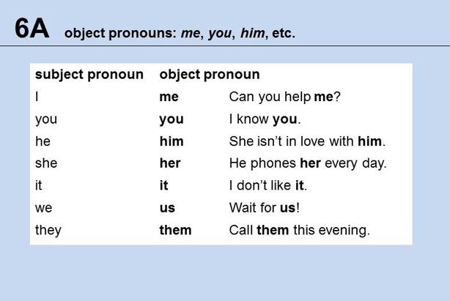
Memorize them with a preposition (TO)

Slide 8
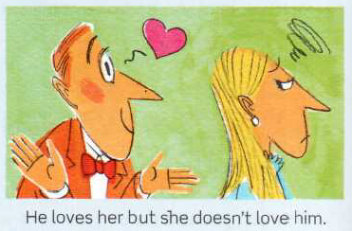

Slide 9
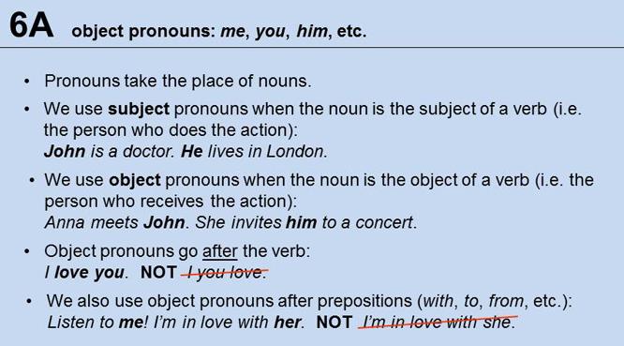

Slide 10
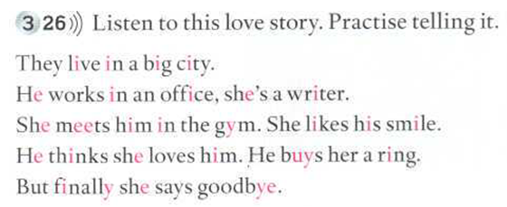
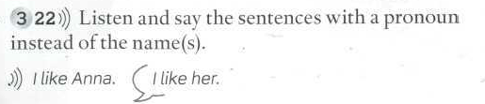
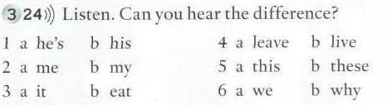
Listen, read, repeat, practise!
Anna
Your husband
Jane and me
David and Sally
This song
Catherine and Richard
My brother and me
These shoes
Susana
Jack
Which one can you hear? a or b?

Slide 11
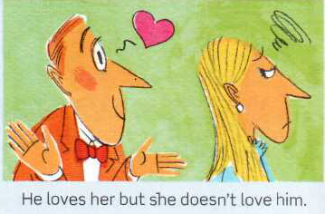
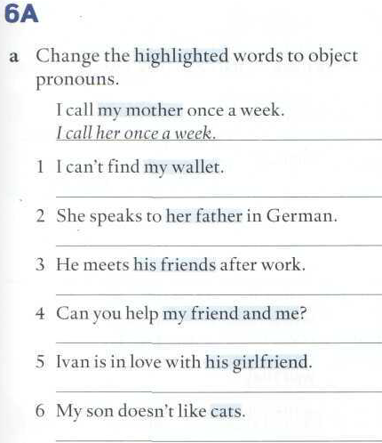
135
I can’t find it.
She speaks to him in German.
He meets them after work.
Can you help us?
Ivan is in love with her.
My son doesn’t like them.

Slide 12
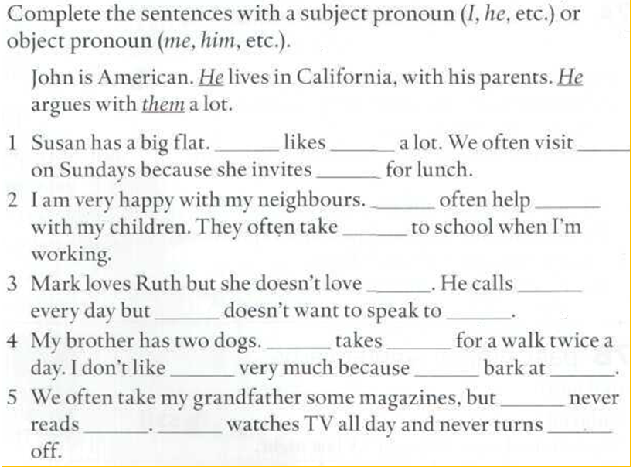
She
it
her
us
They
me
them
him
her
She
him
He
them
them
they
me
he
them
He
it

Slide 13
